Slide 1
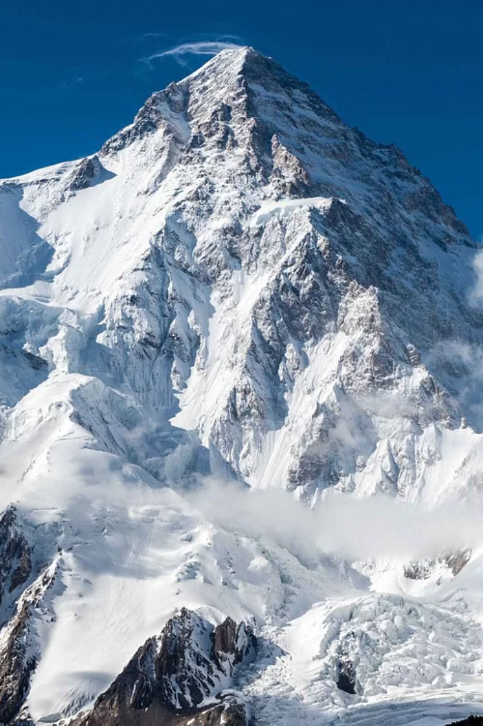

Trekking Website
Embark on unforgettable outdoor adventures in the heart of India's majestic landscapes. Discover breathtaking peaks, serene valleys, and ancient trails that will captivate your senses and challenge your spirit.
Name : URVAL Shah
Roll : 106
Enrollment : 22002170110170

Slide 2
Featured Trekking Destinations
1
Ladakh: Moonscape Treks
2
Uttarakhand: Spiritual Paths
Traverse the high-altitude desert landscapes of Ladakh, where ancient monasteries and turquoise lakes dot the horizon.
Follow in the footsteps of pilgrims through the sacred Uttarakhand region, home to revered Hindu temples and serene ashrams.
Coorg: Tropical Treks
3
Himachal: Snowflake Wonders
4
Discover the lush, misty forests and cascading snow of Himachal, the "Austria of the North".
Immerse yourself in the verdant, tropical landscapes of Coorg, where tea plantations and tranquil rainy forests.

Slide 3
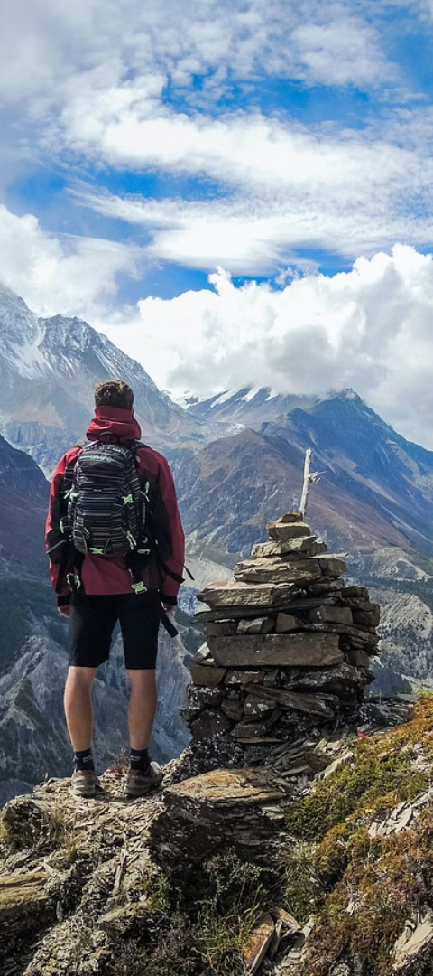



Features
Homepage with Trekking Section
Trekking FAQs
Photos Galleries

Slide 4
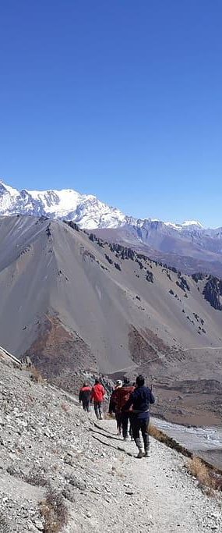
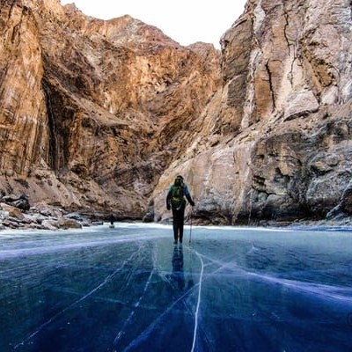
Advantages
Limitations
Cost-Effective Development
Fast Loading Speeds
Portability
Limited Functionality
No use of Back-end
Limited Interactivity

Slide 5
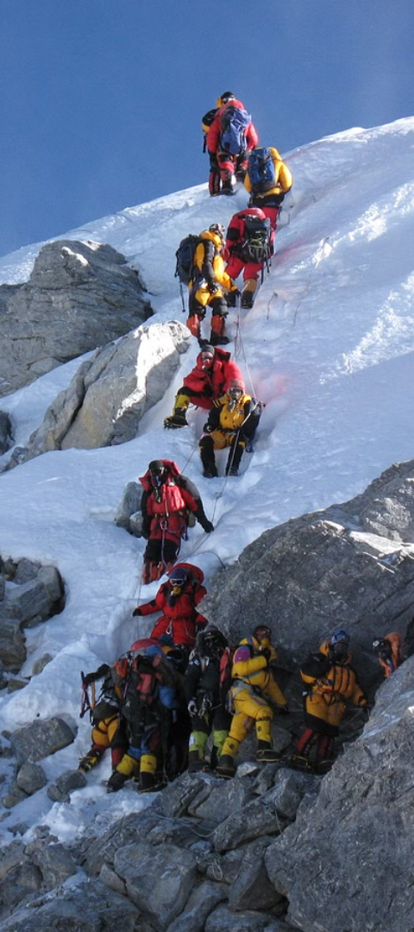
Future Scope
1
Integration with Backend
2
Interactive Mapping and Geolocation
3
E-Commerce Functionality

Slide 6
THANK YOU!

